Slide 1
Council of Delegates
Classis Huron
Spring 2026
Notes:
Introduce yourself as a member of Council of Delegates

Slide 2
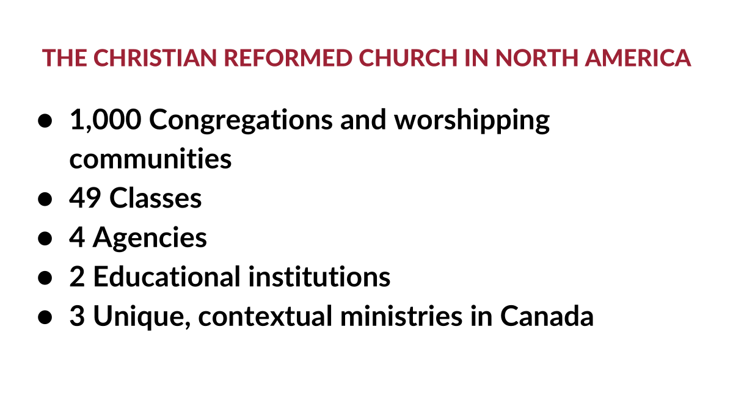

Slide 3
Governance of The CRCNA
Local Congregations
*
49 Classes
*
Council of Delegates (COD)
(Canadian and American Delegates)
*
Synod
Note: When Synod is not in session, the COD —a body comprised of representatives from each of 49 classes - functions in the interim of synod to address any matters that cannot wait until the next synod or carry out any decisions assigned by synod*

Slide 4
In addition, the church in each country is governed by their own corporate board… 1. CRCNA Canada Corporation (Burlington) 2. CRCNA U.S. Corporation (Grand Rapids) Note: Each Corporation is responsible for denominational office lead by an Executive Director responsible for the work in their own country. Both work with the Office of the General Secretary in delivering support and joint ministry across North America and globally

Slide 5
The 4 Agencies of the CRCNA include:
Thrive - congregational support ministry
Resonate Global Mission - mission agency
ReFrame Ministries - A media outreach ministry
World Renew - A relief and development agency

Slide 6
And two educational institutions…
1. Calvin University
2. Calvin Theological Seminary

Slide 7
3 Unique Justice Ministries in Canada include: The 3 Unique Justice Ministries in Canada : 1. Centre for Public Dialogue promotes a positive voice of Christian faith in Canadian public life that seeks justice, hope, and reconciliation in political dialogue and active citizenship 2. Canadian Indigenous Ministries support healing and reconciliation between Indigenous peoples and non-Indigenous people in Canada. 3. Intercultural Ministries reforming body of Christ in which people from all diverse ethnocultural and racial backgrounds, but especially marginalized groups, experience belonging, unity, and flourishing through intercultural engagement.

Slide 9
Disaffiliating Ministers & Congregations 1. Ministers - since Synod 2024, a significant number of Ministers have left - Normally, an average of 15-20 leave per year - between 2024 and 2026 – 200 have left (not including commissioned pastors) - Not all left because of the HSR - ¾ were active pastors and ¼ of those retired; - ¾ were American; ¼ were Canadian - translates into 10% of total active ministers - 30 % were women decreasing our impact in related ministries

Slide 10
Disaffiliating Ministers & Congregations 1. Ministers (cont’d…) - 40 chaplains have departed decreasing our impact in related ministries – ¼ of all chaplains - 55 congregational ministers have been released– almost matching the number of disaffiliating churches

Slide 11
Disaffiliating Ministers & Congregations 2. Disaffiliating Churches - 59 churches across NA… 42 in the US and 17 (of 230) in Canada … 7 % of CRC churches and 10,000 members - ‘without reservation’ is the largest challenge - compared to the Reformed Churches which lost a ¼ of their churches and half of their confessing members - theological differences in the 1990s led to the release of 60 pastors and disaffiliation of 40 churches - we call upon everyone to be intentional in prayer for reconciled relationships us

Slide 12
Retirements and Hires Thrive – Director Leslie Van Milligan retiring and replaced by Lee Carter Reframe Ministries – Director Kurt Selles retiring and replaced by Rev. Darrel Delaney The Banner - Editor: Rev. Lora Copley Calvin Seminary – Jul Medeblik – Retiring Director of Communications and Marketing – Kristen Vandenburg taken a new job

Slide 13
Resonate - Mission
A 10-year church planting plan will be presented to Synod 2026
Ask includes stable funding, strengthening classis involvement, activating existing resources and fostering broader participation
Currently Classis and Resonate support 59 church plants but the work of church planting remains uneven across the denomination
Ownership of church planting persists. Planting is fundamentally the work of local congregations/classes, while Resonate serves as a partner providing support.
Financial constraints continue to shape CRCNA’s capacity for church planting
Church planting is not only about starting new congregations; it’s a sign of spiritual renewal
.

Slide 14
Resonate - Mission
Ownership of church planting persists. Planting is fundamentally the work of local congregations/classes, while Resonate serves as a partner providing support.
Financial constraints continue to shape CRCNA’s capacity for church planting
Divided into two five-year strategy plans with a vision to plant 150 new communities across North America by 2031
across North America by 2031
- If every classis in the CRCNA has a sustainable church multiplication pathway in place that helps local churches make disciples, develop leaders, equip planters, and plant new churches, then 150 new worshipping communities will be established across the US and Canada by 2031
To support the vision, there are 5 strategic priorities identified:
Discipleship Multiplication
Leadership Development
Church Planting Pathways
Legacy Pathway
Funding and Capacity Development
Church planting is not only about starting new congregations; it’s a sign of spiritual renewal
.

Slide 15
Resonate - Mission
Every classis in the CRCNA will require:
a sustainable church multiplication pathway in place that helps local churches make disciples
resources to develop leaders
resources to equip planters
funding capacity
Church planting is not only about starting new congregations…it’s a sign of spiritual renewal
.
Church planting is not only about starting new congregations; it’s a sign of spiritual renewal
.

Slide 16
Church Renewal – Thriving Congregations
In 2023 Synod mandated the denomination develop a Church Renewal Plan
Invitation to congregations to prioritize activities in two areas - nurturing spiritual growth and missional engagement … a return to the ‘mission of God
Only 11% of churches believed they had a hands-on commitment to the unchurched
.
.

Slide 17
Church Renewal – Thriving Congregations
The GATHER initiative in 2024-25 allowed churches to share their ideas for renewal. One of the key findings was the lack of a clear disciple-making process and a lack of leadership and volunteerism
In developing the journey for renewal, the report begins with Thriving Essentials – a one day course designed for elders, deacons and pastors on how to align leaders on the 4 key paradigms around mission, discipleship, discernment and leadership
Thrive and Resonate will provide the support to Classis and congregations
.
.

Slide 18
Ministry Shares
Ministry Shares continue to be a challenge but recent donations and shares are seeing an uptick from a year earlier…putting us in a stronger financial position.
Shares are critical to balanced budgets and ministery funding
Some of this decline can be attributed to fewer members in the CRC, but the reality is that individual member giving is down by about 40 %
Some funding is derived from large donors. In Canada, we have 12 major donors

Slide 19
Ministry Shares (cont’d…)
We ask churches to explore strategies to increase pledges and donations
How do we get non-CRC donors to give to our ministeries and how do we work with individual church members to increased giving
The challenges can be overcome by:
- Deepening our commitment to local and global outreach
- Call the next generation to service
- Invite God to use us in different ways

Slide 20
Becoming a Council Delegate…
Not an easy task to find volunteer Council delegates
Each year we need an average 4-5 new delegates across Canada to replace delegates at the end of their term – both classical and at-large delegates
You do not need to be a pastor, office bearer or have a particular set of skills…just a member in good standing and an interest in leadership
You can even nominate yourself
Visit the CRCNA website and search on Nomination

Slide 21
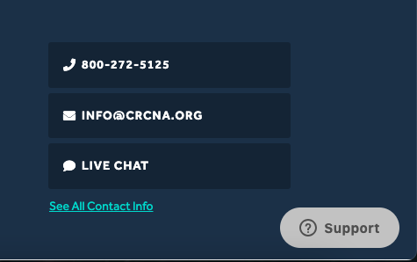
Questions and Contact Information
Have a question about denominational matters… contact me and we’ll connect you with the right person!
Peter Meerveld
peter.meerveld@sympatico.ca

