Slide 1
Classis Huron, February, 2023
Thanks for the invitation to share what God is doing through your support.
In 2022, the churches of Classis Huron donated $555,345.64.

Slide 2
What World Renew does:
Domestic disaster response
International disaster response
Rehabilitation
Transformational community development
Justice, including refugee sponsorship

Slide 3
Our Approach
3
Notes:
This is a copy heavy slide. You can duplicate this slide as many times as you need to fit your content on the slide. You can also add visuals to this slide if needed. If possible, try to avoid clipart and stock images; we prefer to use authentic World Renew photography and visuals wherever possible. Also, be sensitive to font size, if a slide requires you to drop down to a font smaller than 14pt, consider putting content on another slide. We want to ensure our presentations are readable, particularly for those who struggle with visual impairments. Also, don’t forget to give this slide a heading!

Slide 4
Our Priorities
4
Deepen our capacity and culture of accountability
Enable innovation
Agility
Sharp focus, clear context, strong programming results
Coherence, not conformity
Shift power
Boldly articulate our organizational identity
Notes:
This is a copy heavy slide. You can duplicate this slide as many times as you need to fit your content on the slide. You can also add visuals to this slide if needed. If possible, try to avoid clipart and stock images; we prefer to use authentic World Renew photography and visuals wherever possible. Also, be sensitive to font size, if a slide requires you to drop down to a font smaller than 14pt, consider putting content on another slide. We want to ensure our presentations are readable, particularly for those who struggle with visual impairments. Also, don’t forget to give this slide a heading!

Slide 5
Our Affiliations
5
Notes:
This is a copy heavy slide. You can duplicate this slide as many times as you need to fit your content on the slide. You can also add visuals to this slide if needed. If possible, try to avoid clipart and stock images; we prefer to use authentic World Renew photography and visuals wherever possible. Also, be sensitive to font size, if a slide requires you to drop down to a font smaller than 14pt, consider putting content on another slide. We want to ensure our presentations are readable, particularly for those who struggle with visual impairments. Also, don’t forget to give this slide a heading!

Slide 6
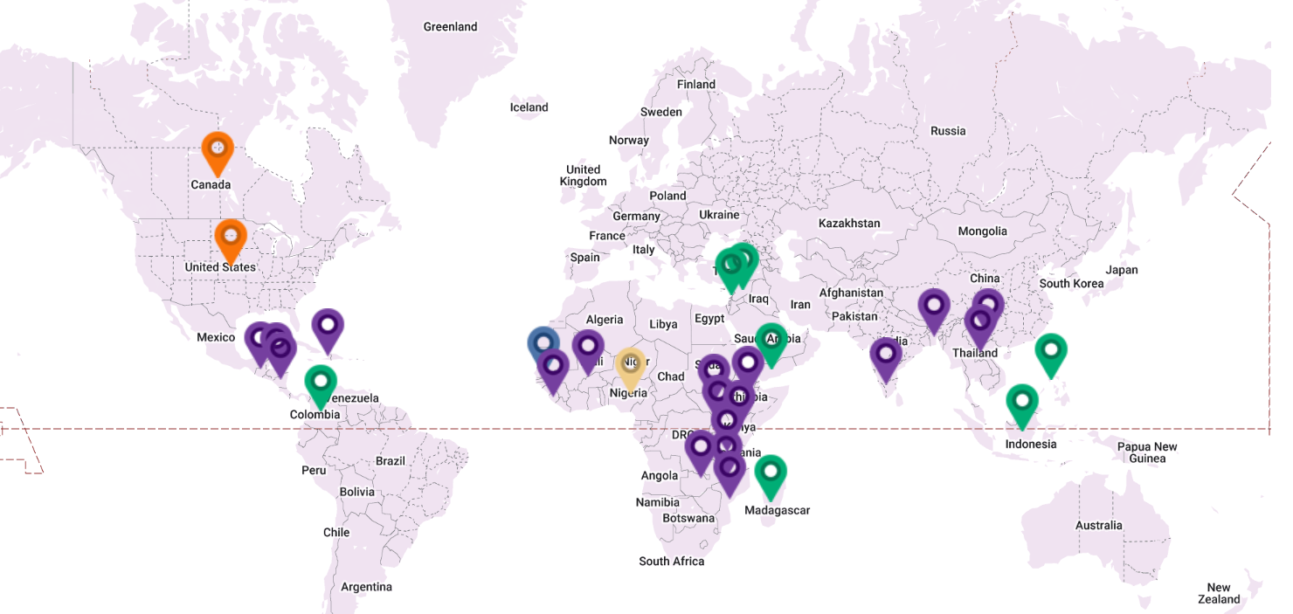
Where we work
6
Section Header
Notes:
Sometimes, you need a slide with a bulleted list. This is that slide! Don’t forget to give the slide a title.

Slide 7
North American and global disaster response and rehabilitation
World Renew responds to urgent needs. In North America, this often includes clearing debris, assessing needs, training local leaders, and repairing and rebuilding damaged homes.
Internationally, it includes providing and distributing emergency food, water, shelter, and other supplies. It also often involves the rebuilding of homes and livelihoods.

Slide 8
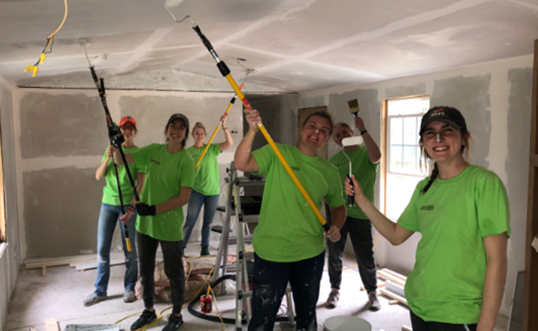
Disaster Response Services
What DRS does:
-Early assessment
-Cleanup and debris removal
-Unmet needs assessment
-Organizational capacity building
-Reconstruction
-Construction estimating.
….all in partnership with other organizations and volunteers.
SINCE 1970: 7,500 homes repaired, by 44,000 volunteers;
DRS became 50 years old last year!!!!

Slide 10
Disaster Response
Notes:
To many of you, the most familiar part of World Renew’s work is our Disaster Response. (Check if there are any DRS volunteers ahead of time)

Slide 11
On October, 2022, World Renew had projects in 21 countries, impacting just under 500,000 participants, with $13,102,588 committed (this is a fluctuating number)

Slide 12
International Disaster Response (IDR)
12
Section Header
c. 50 International Disaster Response (IDR) projects on the go; number of participants: anywhere from 500 – 12,000 people, or 200 – 2000 households.
Notes:
Sometimes, you need a slide with a bulleted list. This is that slide! Don’t forget to give the slide a title.

Slide 13
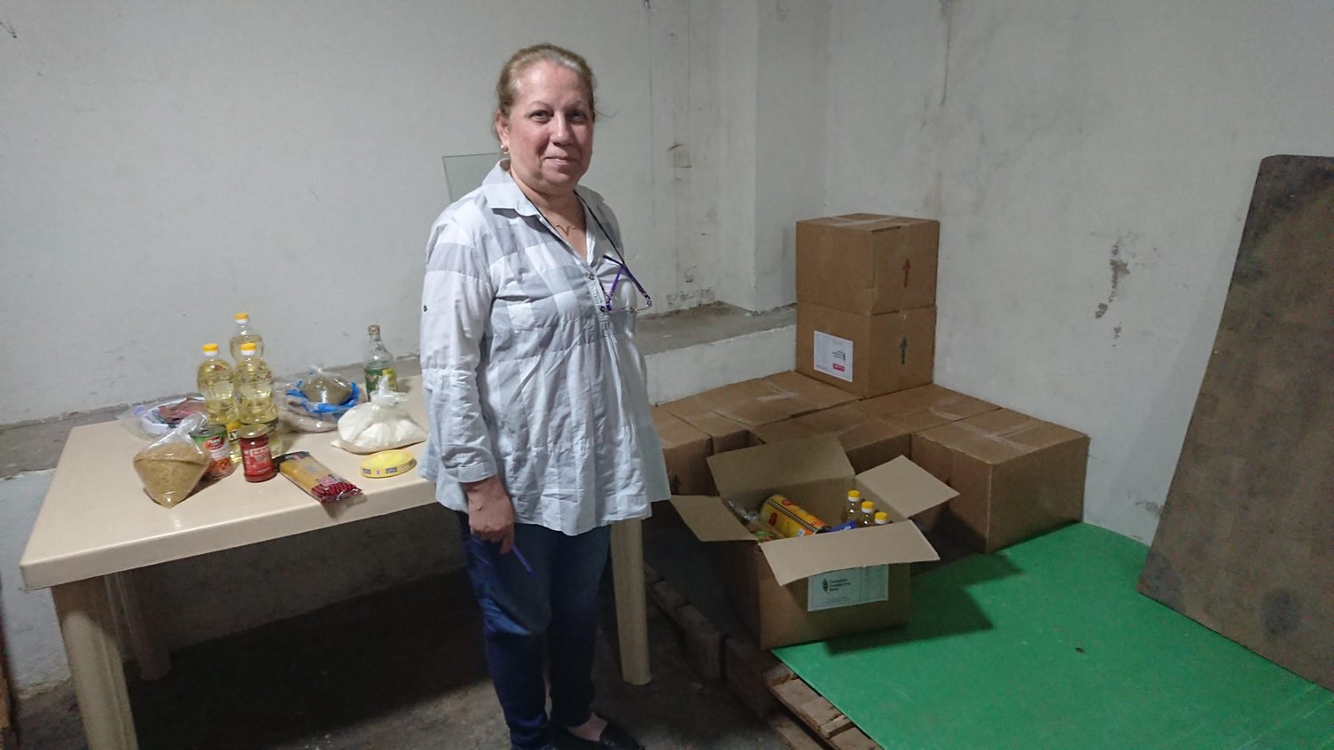
Syrian Refugee Crisis
13
Section Header
.
Notes:
Sometimes, you need a slide with a bulleted list. This is that slide! Don’t forget to give the slide a title.

Slide 14
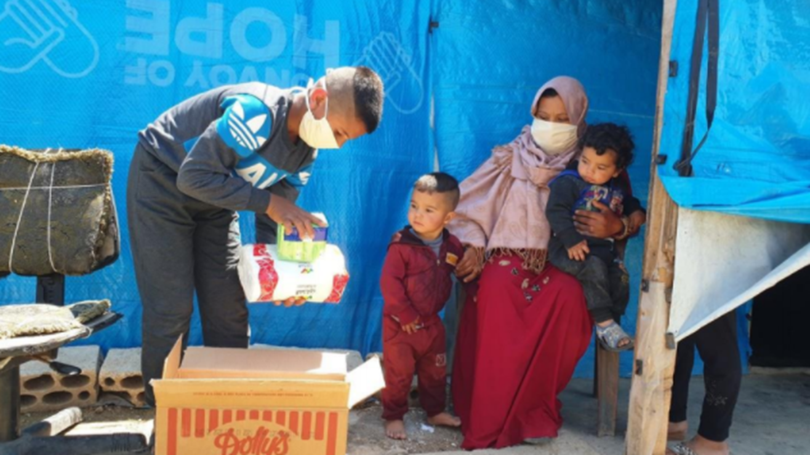

Slide 15
Ukraine Response (IDR)
15
Section Header
As of yesterday morning, (Feb. 14), donations are:
$2,561,400 CAD,
$2,696,161 USD
Notes:
Sometimes, you need a slide with a bulleted list. This is that slide! Don’t forget to give the slide a title.

Slide 16
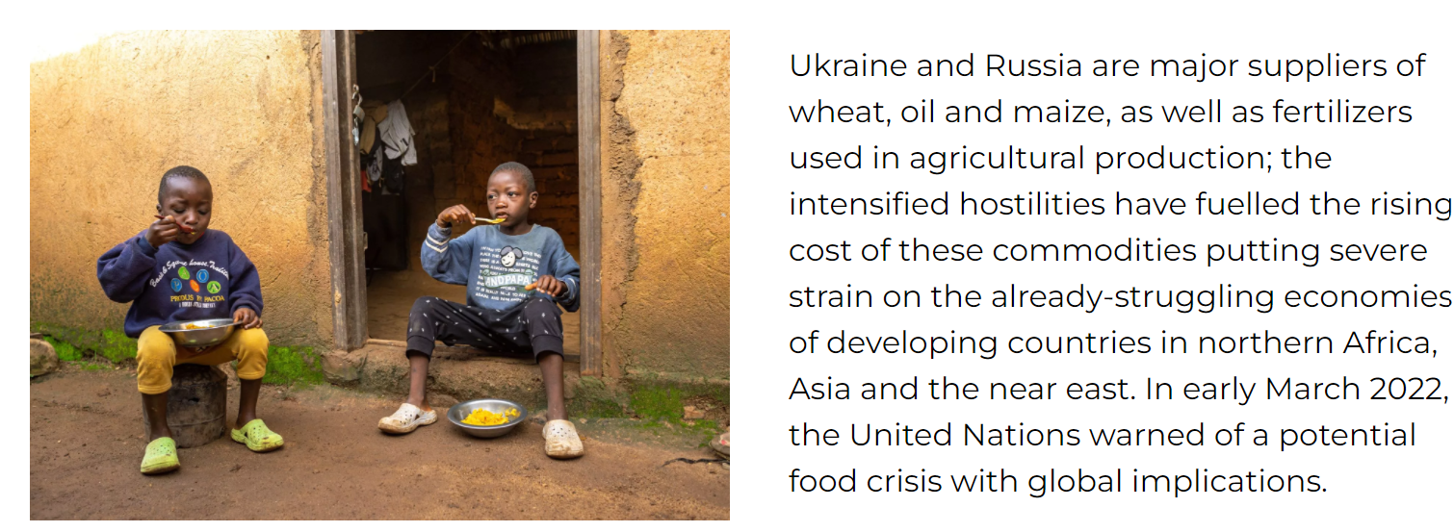
Global Food Crisis Response (IDR)
16
Section Header
Notes:
Sometimes, you need a slide with a bulleted list. This is that slide! Don’t forget to give the slide a title.

Slide 17
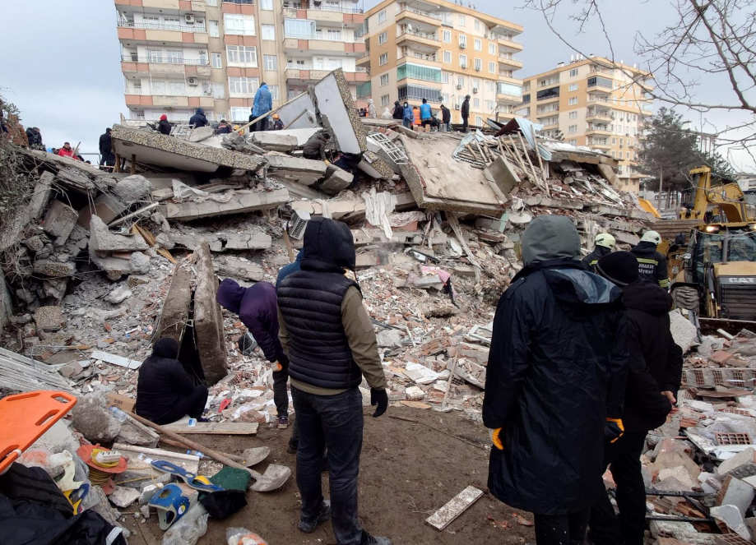
International Disaster Response (IDR): Turkey/Syria
17
Section Header
World Renew has already released initial funds to meet initial emergency needs in earthquake response. The organization is making plans to provide additional immediate aid as our partners assess the losses of those who are the most vulnerable in this catastrophic disaster. Through long-term, local partners, World Renew has provided emergency assistance to displaced people in this area for more than a decade.
Notes:
Sometimes, you need a slide with a bulleted list. This is that slide! Don’t forget to give the slide a title.

Slide 18
How specifically shall we treat victims of disasters? Globally and domestically.
How specifically shall we interact with victims of disasters? Globally and domestically.

Slide 19
Core Humanitarian Standard

Slide 20
CHS: Nine Commitments Humanitarian response:
1. is appropriate and relevant to the needs of the communities and the people.
2. is effective and timely; communities and people receive assistance at the right time.
3. strengthens local capacities and avoids negative effects; communities and people affected by crisis are more prepared, resilient and less at risk as a result of the humanitarian action.
4. is based on communication, participation and feedback; communities and people have access to information, and participate in decisions that affect them.

Slide 21
CHS: Nine Commitments
5. Complaints are welcomed and addressed.
6. Humanitarian Response is coordinated with other organizations, and complementary.
7. Humanitarian organizations and agencies continuously learn and improve.
8. Staff are supported to do their job effectively and are treated fairly and equitably.
9. Resources are managed and used responsibly for their intended purpose

Slide 22
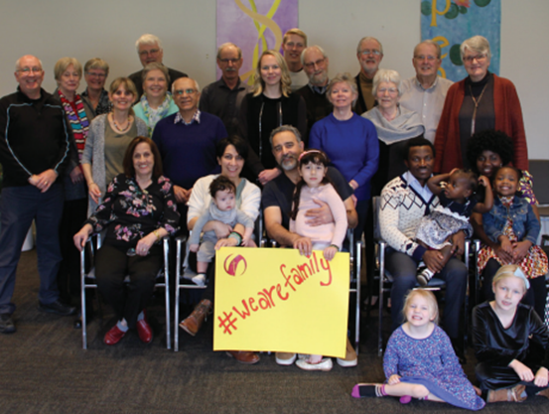
The Refugee Program by Dec. 31/22:
-July/22, we received our annual allocation of 175 persons, + 20 persons for the Operation Afghan Safety (OAS)
-last year: 193 refugees arrived and were resettled.
-we submitted applications for 44 persons under Operation Afghan Safety.
-currently: 16 sponsoring groups are working on applications for 73 refugees.
-73 churches across Canada sponsored and resettled refugees in 2022.
-87 groups waiting for 358 refuges to arrive.
SINCE 1979: +11,000 REFUGEES

Slide 23
Key to World Renew (and DMC): A.B.C.D…
Asset-Based Community Development:
Discovering Strengths
Organizing & Mapping
Mobilizing
Community-driven initiatives
Sustaining the process
Notes:
Optional slide

Slide 24
SOME CONSEQUENCES OF A NEEDS BASED MODEL
Community adopts view of outside world and develops poor self-image: “We are deficient; our community is deficient.”
Deficient people are unable to enter into positive, productive relationships, and are unable to contribute.
Most money comes into the community for programs and professional helpers, not residents.
Community leaders learn to magnify deficiencies.
Failure is rewarded and dependency is fostered.
The community experiences hopelessness and defeat.

Slide 25
SOME CONSEQUENCES OF ASSET BASED MODEL
The community adopts a more positive self-image.
The community displays a “can do” attitude.
Residents feel validated as worthwhile, capable.
Resident see possibilities and not just problems.
Residents see themselves as the co-producers of their own well being.
The community feels more powerful.
Residents see that they are not alone, that there are partners for them in community work.

Slide 26
Mrs. Magdalena Mashauri and Mr. Mashauri Nyamonge, Tanzania

Slide 27
Kitchen Garden

Slide 28
After all, no problem can be really solved from the outside!

Slide 29
Village Savings and Loans
-These programs work by focusing on the resources, initiative, accountability and social support that are present in vulnerable communities.
-Groups of 15-30 members make weekly savings deposits into a group fund.
-Manage the fund themselves, make decisions about who can receive loans and what the terms are, and hold each other accountable for the repayment of their loans.
-This kind of accountability leads to very high repayment rates.

Slide 31
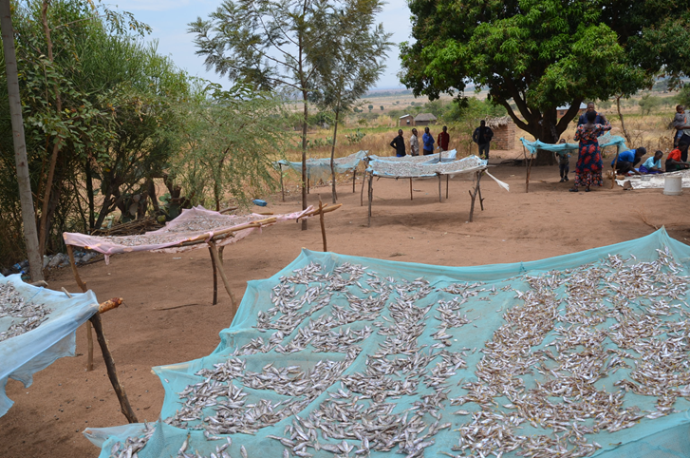
Mrs. Chausoku Mayala and Mr. Mayala Nyamonge, Tanzania

Slide 32
Thanks for this time together! May God continue to bless us all, Classis Huron.
“Not all of us can do big things, but we can do small things with great love. “
Mother Teresa.

